Slide 1
Sigma-3000 / Sigma-4000
보드 공용화 개발
Creativity & Confidence
www.atikorea.com

Slide 2
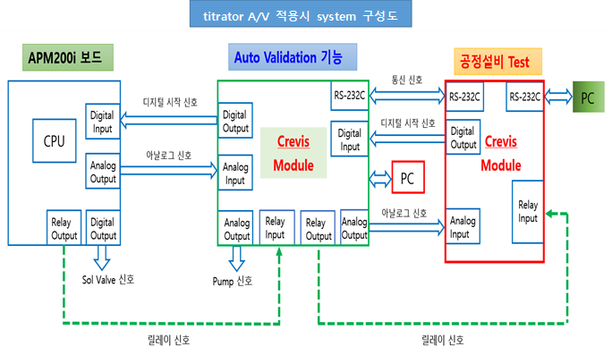
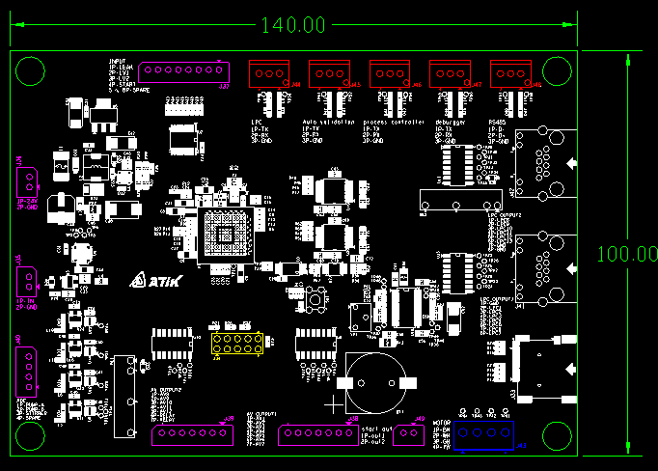
2. Test 항목 - 1) calibration - HF
■ Sigma-3000/4000 Board Function List
 | Sigma-1000 | Sigma-3000/4000 (개발 계획서)
Power | 24V | 24V
Ethernet | - | -
UART1 | LPC | Apm200i
UART2 | Auto validation(Panel PC) | PC
UART3 | PLC | PLC
UART4 | DEBUG | DEBUG
UART5 | RS485 | -
Analog Input (External 16bit ADC) | 1 (0~5V) | 4 (4~20mA)
Analog Output (External 12bit DAC) | 4 (0~5V) | 4 (4~20mA)
Digital Input (NPN) | 8 (0~5V) | 16 (0~24V)
Digital Output | Open Collector | Relay 제어
 | 13 (A/V) 13 (LPC) 1 (LPC Start) | 16
 | General output
 | 8 (Stir.)
Log | SD Card

Slide 3
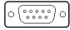


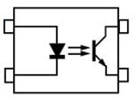

2. Test 항목 - 1) calibration - HF
■ Sigma-3000/4000 Board Block Diagram
APM200i
Panel mount
Sigma-3000/4000 Board
Buck
(DC 5V)
POWER#3
(DC 24V)
POWER#1
(AC 220V)
D-Sub
5Pin
MCU
STM32F407
LDO
(3.3V)
RS232
Female
9Pin
Analog Output
RS232
(APM200i)
APM200i
RS232
(Isolator)
UART#3
UART#1
RS232
(Isolator)
Debug
Start signal 4-Port
(Digital Input)
24V
Male
9Pin
PLC
RS232
RS232
(PLC)
RS232
(Isolator)
UART#6
UART#2
Panel PC
Relay 8-Port
(Digital Output)
4-20mA
Input
(APM200i)
4-Port
4~20mA x 4
ADC 4ch
AD7682
SPI#2
Male
16Pin
SDIO
Micro
SD Card
4-20mA
Output
(PLC)
4-Port
4~20mA x 4
DAC 1ch
LTC2601 / XTR111
x4
PLC
DAC 1ch
LTC2630
x4
I2C#3
EEPROM
POWER#2
D-Sub
5Pin
Digital
Output
(PLC)
8-Port
X 8
GPIO
RS232
Female
9Pin
Analog Input
Digital
Output
(APM200i)
4-Port
X 4
Output
(16-Port)
DAC_OD
(4-Port)
Start signal 4-Port
(Digital Output)
24V
Male
9Pin
3.3V
Digital
Input
(APM200i)
8-Port
X 8
Input
(16-Port)
SPI Select
(5-Port)
Relay 8-Port
(Digital Input)
Male
16Pin
Digital
Input
(PLC)
4-Port
X 4
X 16

Slide 4
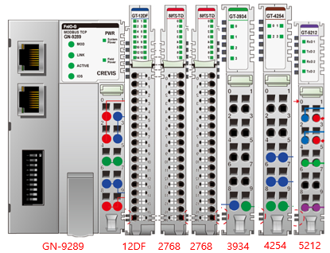
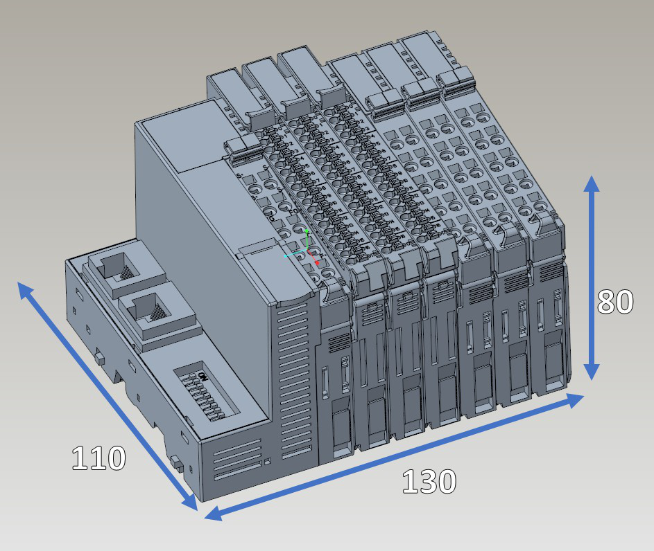
메인보드 160*120*21.5(WDH)
IO보드 230*50*35(WDH)

